Slide 1

Maths
SMART Targets will be set at the beginning of each block of lessons. These targets will be generated using assessment data.
Target: By October Sarah will be able to add and subtract two two-digit numbers with 90% accuracy.

Slide 2

Add two two-digit numbers by partitioning.
Small step that we are hoping to achieve
Partitioning is a process of splitting numbers. In order to add and subtract successfully, children need to be able to partition numbers into tens and ones. This stage is a precursor to use of the ‘column method’ ensuring that children fully understand the value of each number that they are adding which will avoid misconception later.

Slide 3
To support focus and reduce visual stress, our learning slides use a consistent color-coded background system. This creates a "silent communication" between tutor and pupil, letting the student know exactly what is expected of them before they even read the first word. This predictable environment reduces anxiety, helps with visual processing, and allows your child to focus on what matters most: the new concept being introduced.

Slide 4

4 + 3 = 7 so ….
40 + 30 =
40 + 32 =
54 + 3 =
If I know 5 + 3 = 8
What else do I know?
Purple slides review the learning from the previous lesson. This is an essential step which supports children to convert new learning from their short to long term memory. Regular practise at home will also support this.
Wizard challenges (represented by a wizard hat) provide stretch and challenge and require a deeper level of understanding.

Slide 5
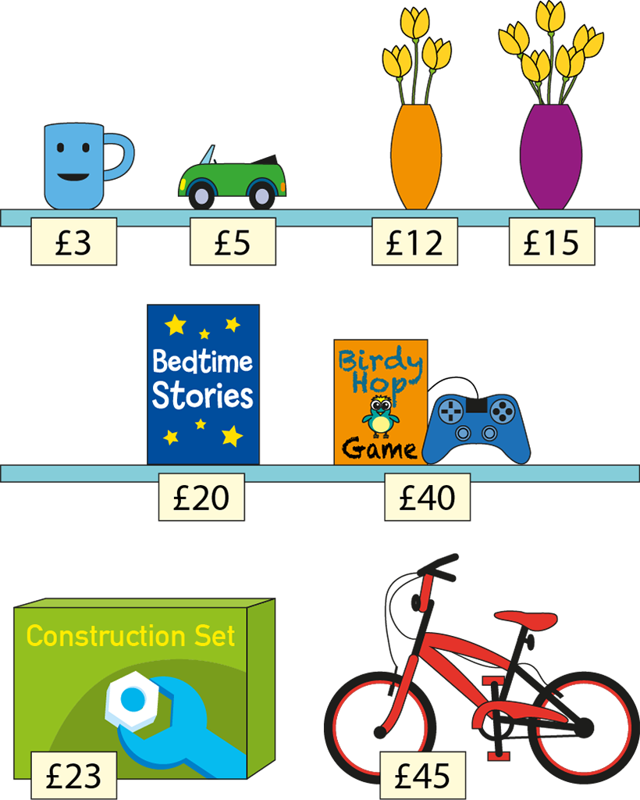
I do
How much does a book, a game, a car, and a mug cost?
Green slides are for teaching. Learning is broken down into small manageable steps that follow an I do, we do, you do cycle. This pattern of teaching promotes independence and ensures success by the end of the lesson .
Notes:
Follow the link to watch the first Numberblocks episode introducing the number 2. Pause the video at various intervals and ask your child how many there are.

Slide 6
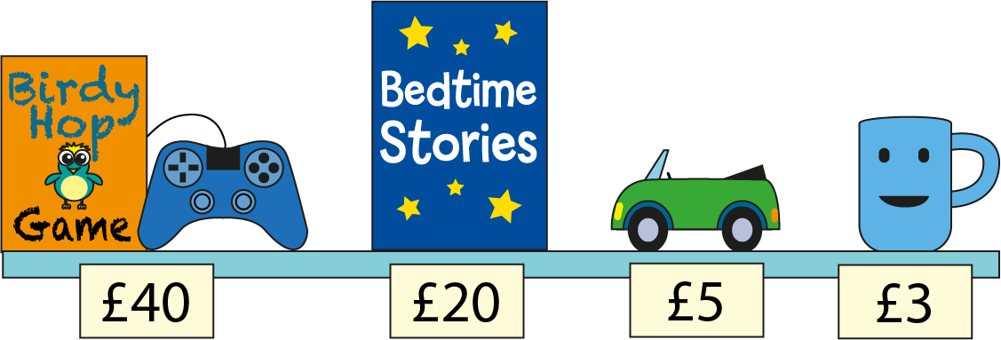


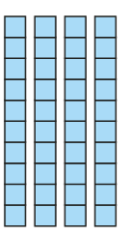











I do
= £68
Concrete resources (base 10) and visual representations of them are used at this stage of the lesson. Using physical items that can be manipulated helps children to understand a new concept being introduced. Pictures can also help children to visualise the maths processes being taught.

Slide 7

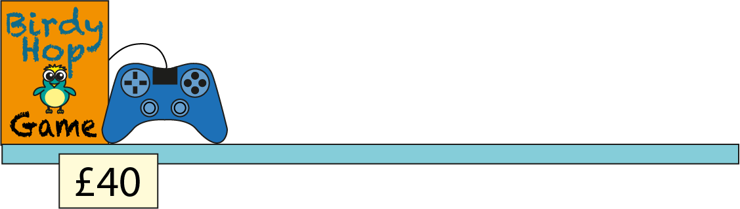

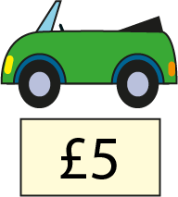





I do
= £68
Here the representation has been varied (the base ten replaced by a bar model). Variation is an essential component of maths lessons used to deepen understanding and avoid misconceptions. The bar model is a key mathematical representation which can be used in many different contexts.
60
+
8

Slide 8




I do
What’s the same? What’s different?
= £68
45
23

Slide 9




45 + 23 = 68
I do
45
23
40 + 5 + 20 + 3 = 68
All lessons are planned in a way that breaks learning into small manageable steps reducing the ‘cognitive load’ that leaners feel when introduced to new concepts. As you can see, the addition of four numbers in the previous slides prepares children for the process of partitioning two digit numbers for the process of addition.

Slide 10
I do
How much does a construction set and purple flower pot cost?

Slide 11
23 + 15 = ?
I do
+
=
23
15

Slide 12
23 + 15 = ?
I do
20 + 3 + 10 + 5 = ?
+
+
+
=
20
10
3
5

Slide 13
We do
How much does a bike and an orange vase cost altogether?

Slide 14
You do
How much does a construction set and a bike cost altogether?
Blue slides are for independent application of the taught skill. This provides an opportunity for tutors to check a pupil’s understanding before moving on.

Slide 15

We do
30 books
3 books
20 books
58 books arrived at school but one of the labels fell off!
Luca says the third box has 7 books.
Nathan says the third box has 5 books.
Who is correct? How do you know?
Reasoning is an important part of the maths curriculum for all year groups. Children need to clearly share their understanding by explaining ‘why’. Although opportunities for reasoning are embedded throughout the lesson, yellow slides provide an opportunity to dive deeper!

Slide 16
I now know …
Orange slides promote metacognition. They provide children with an opportunity to reflect upon what they have learnt in the session and express it in their own words.

Slide 17
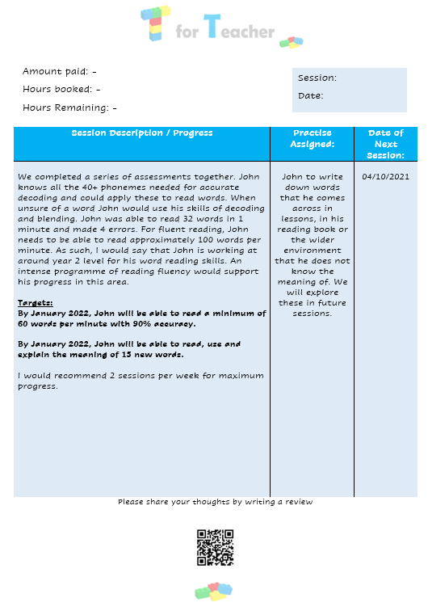
Session Report:
At the end of each lesson a session report will be sent to you. This will provide a description of the work completed during the lesson and will comment on your child’s progress towards their current target.

